Slide 1
Synapse
Developing first handshakes into genuine connections
A4ever
Notes:
:40 s

Slide 2
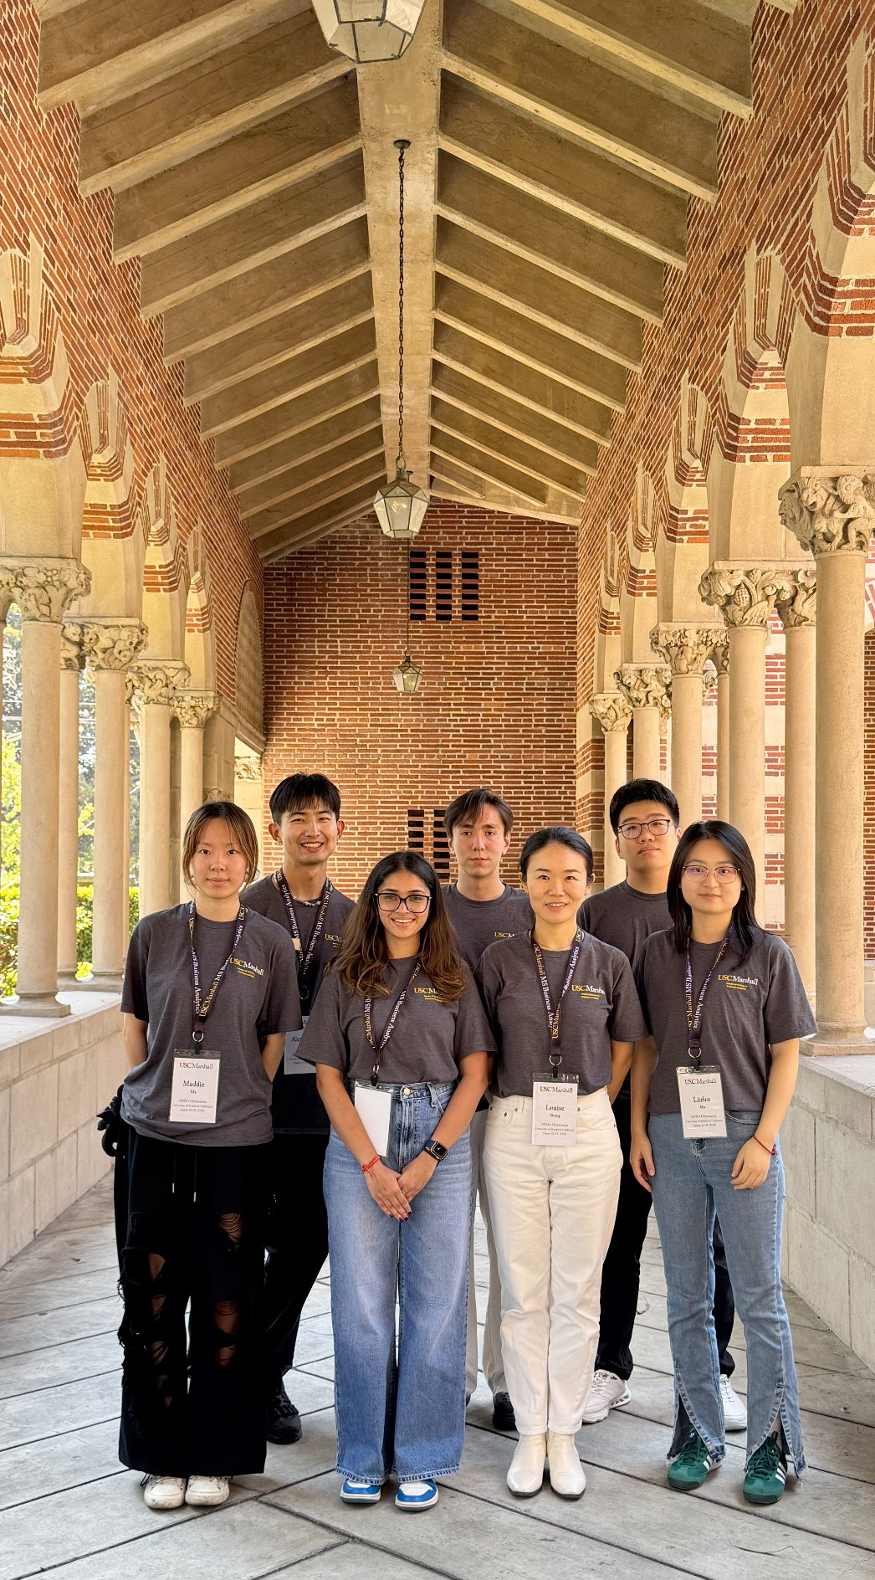



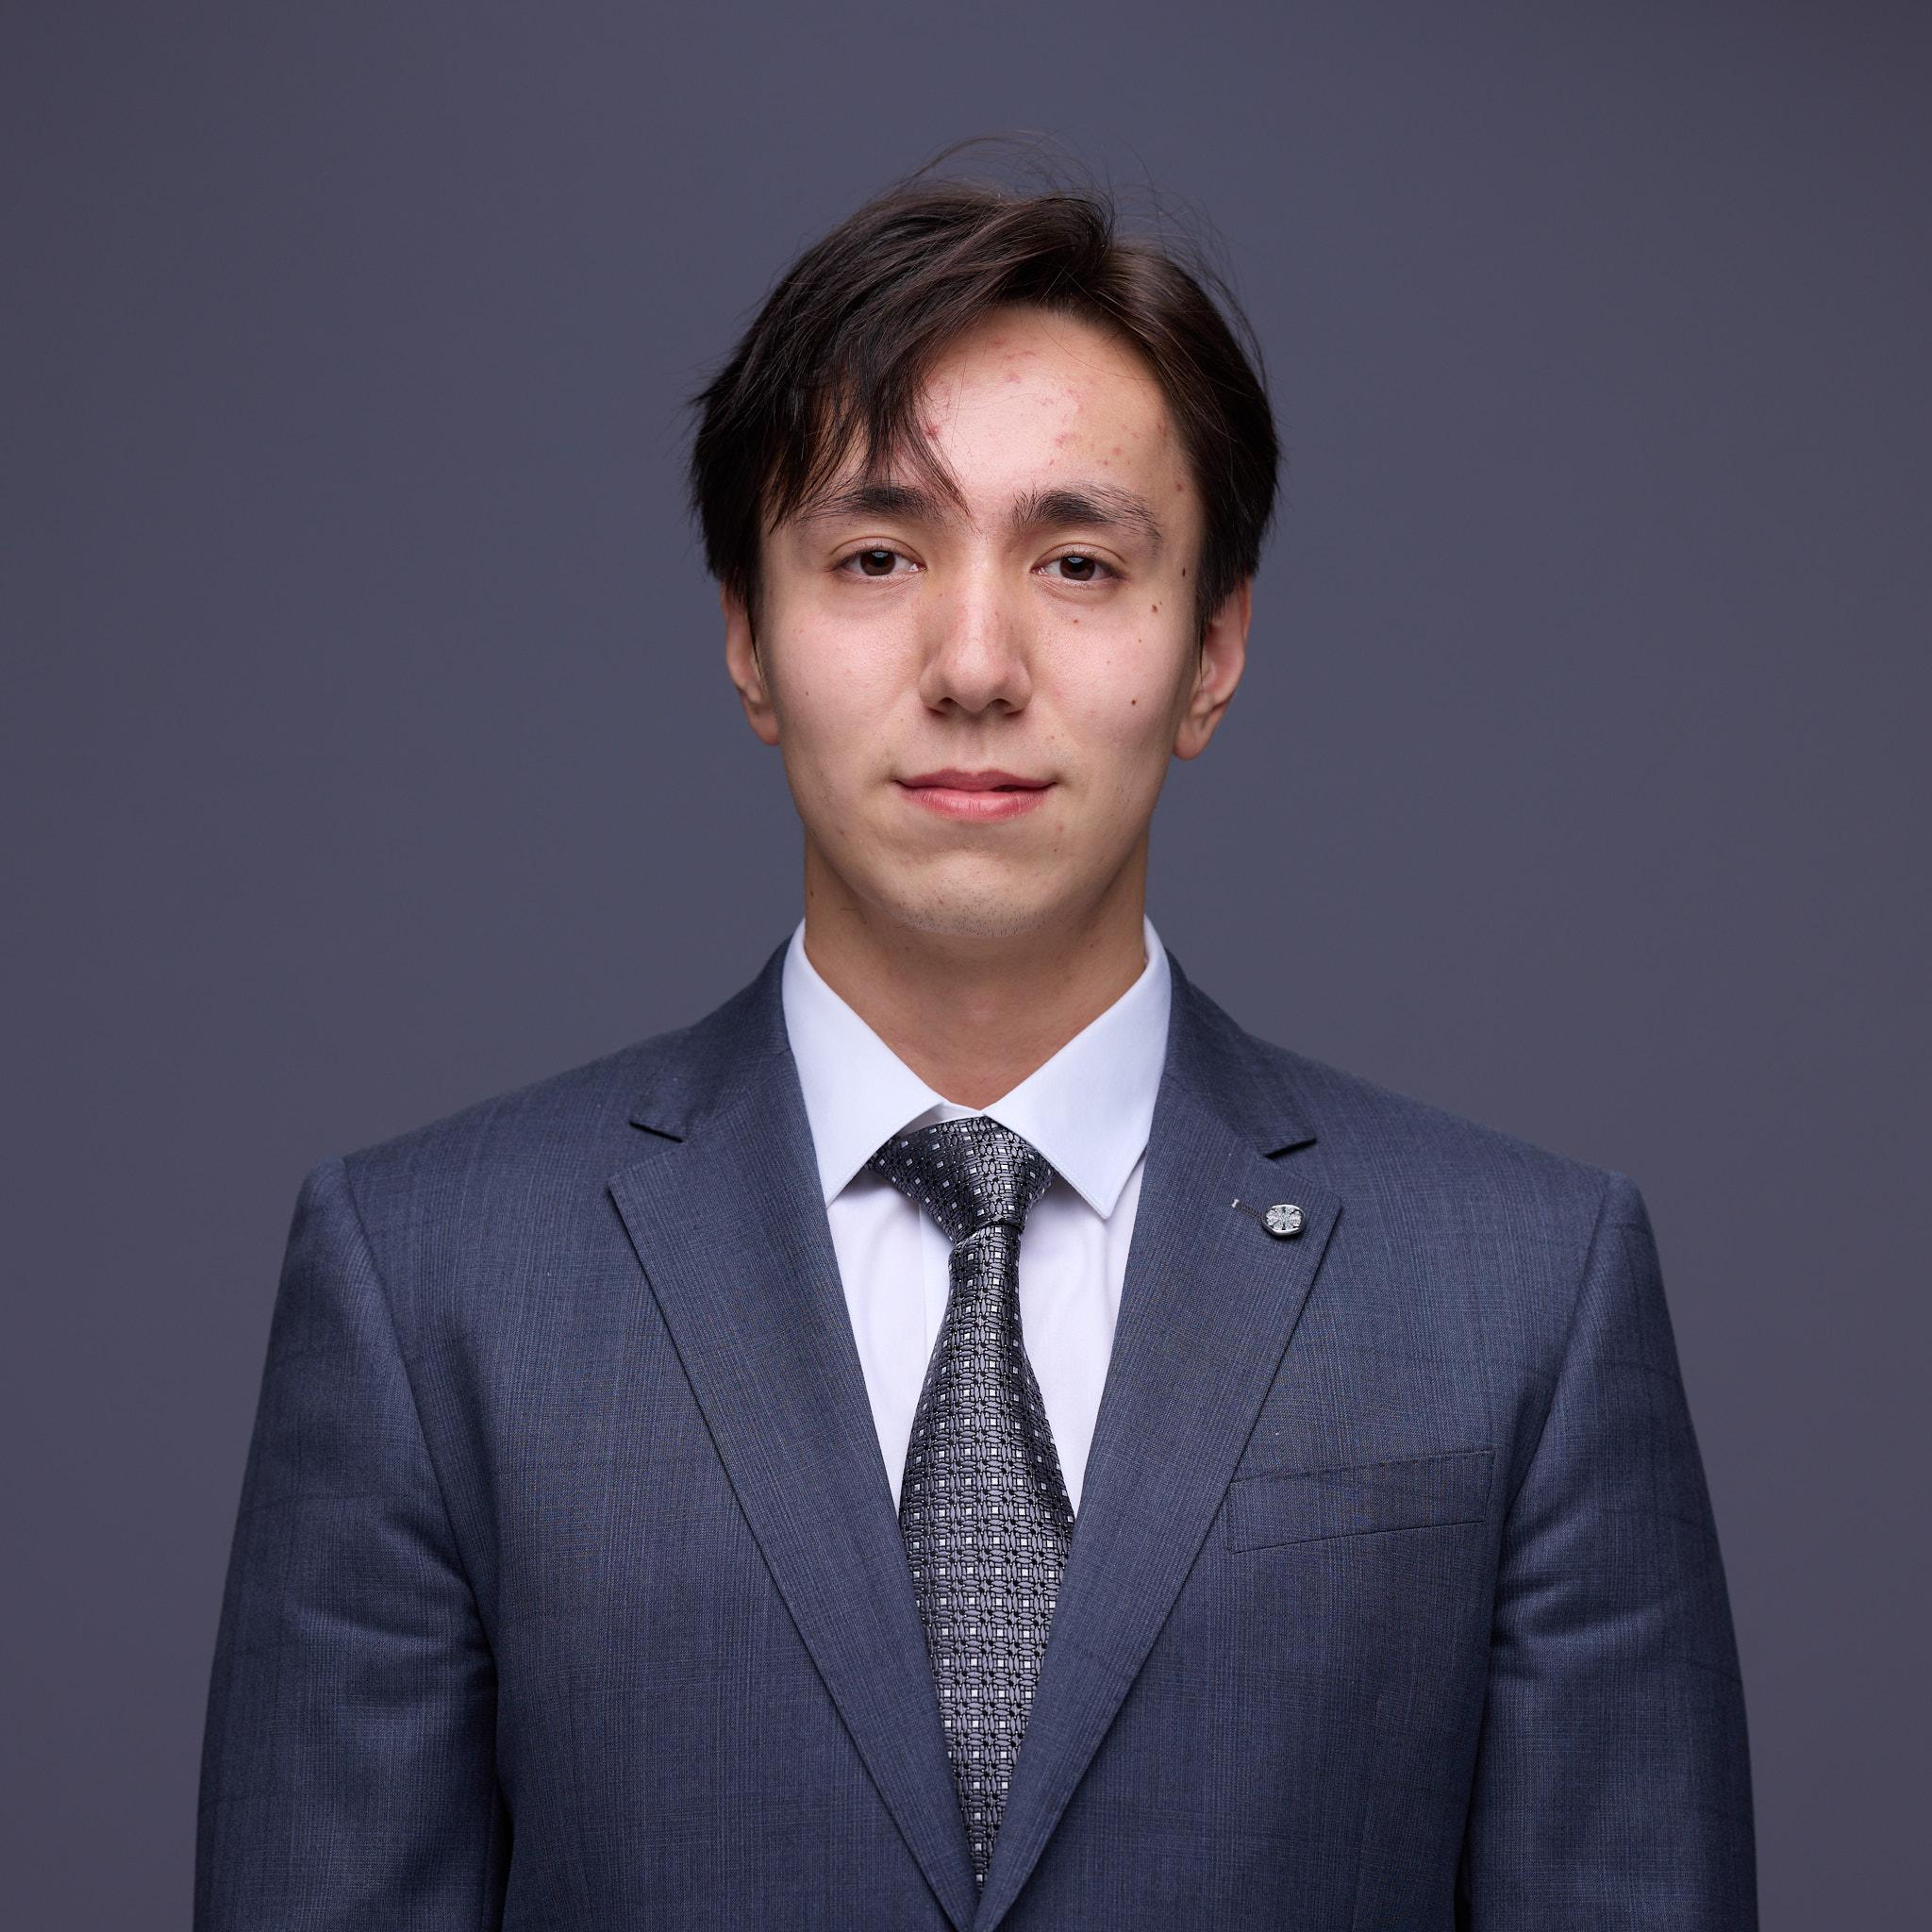
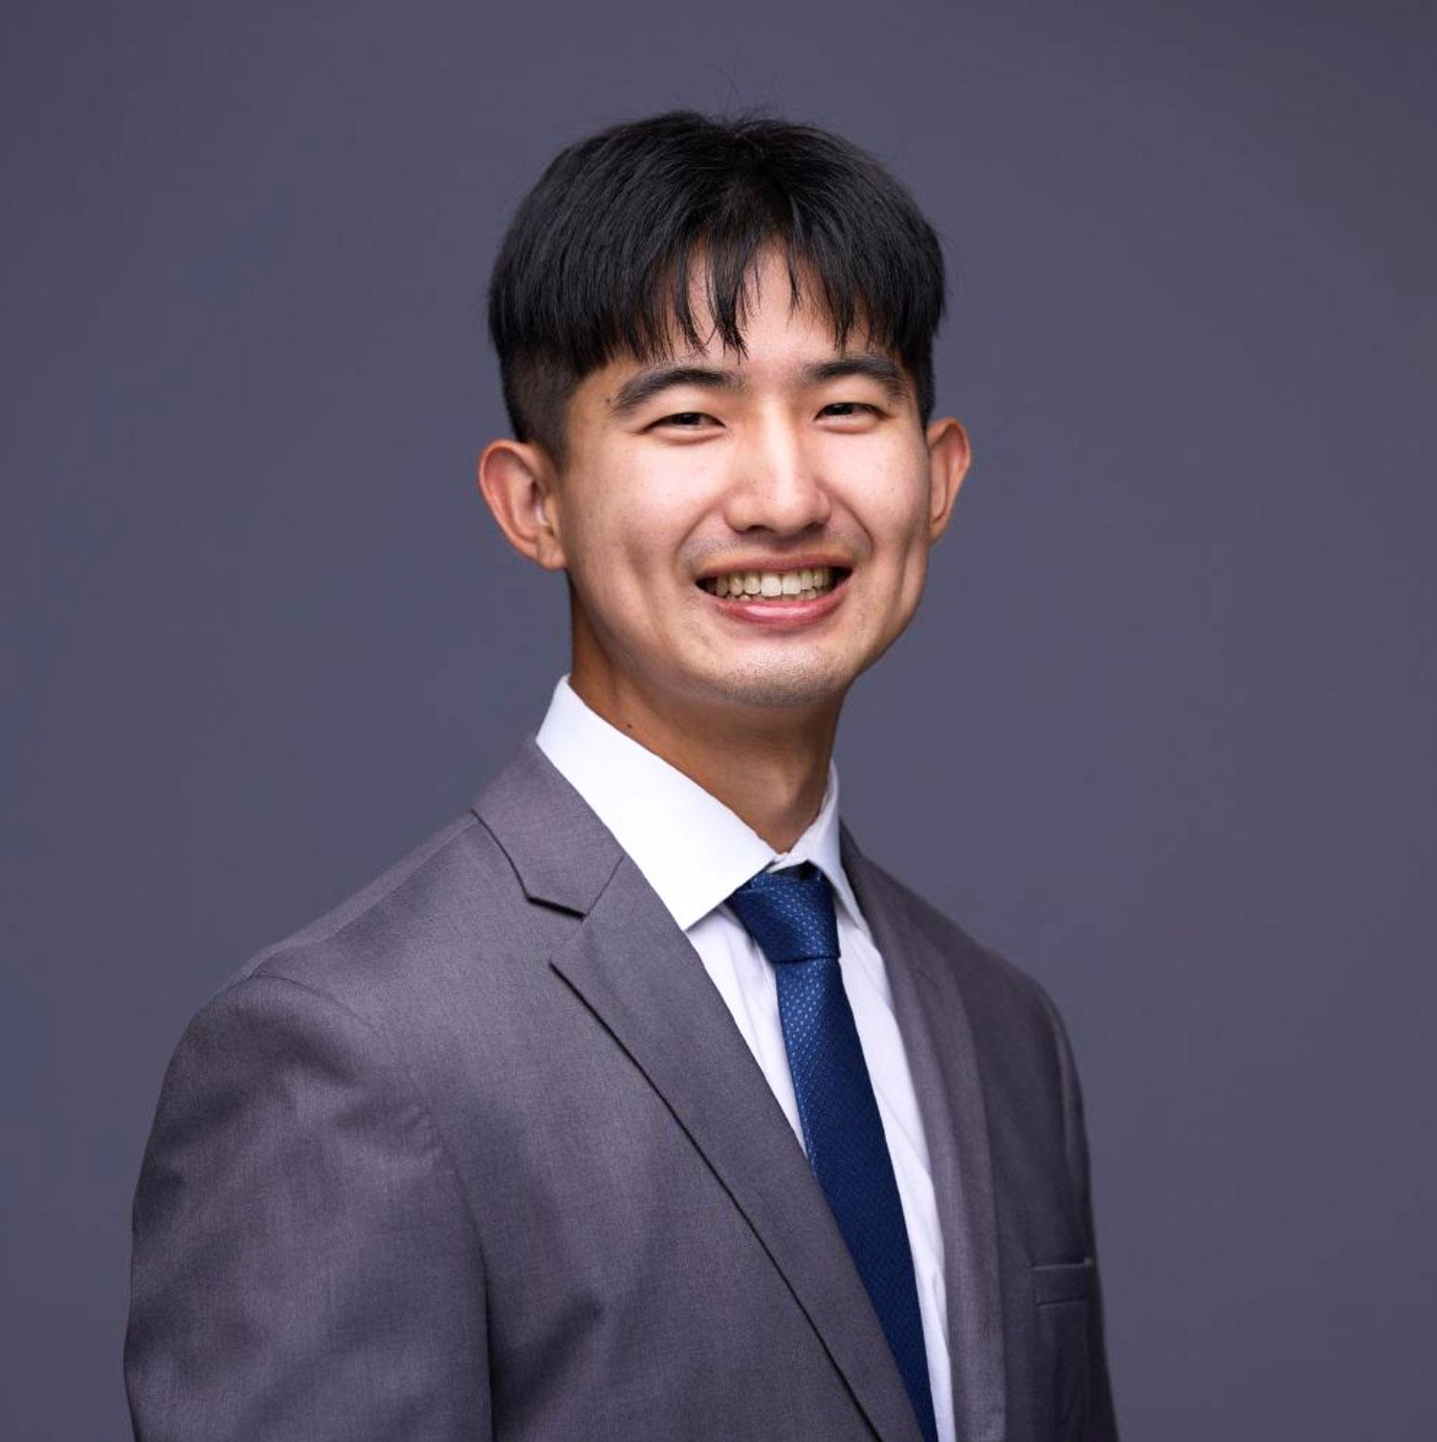

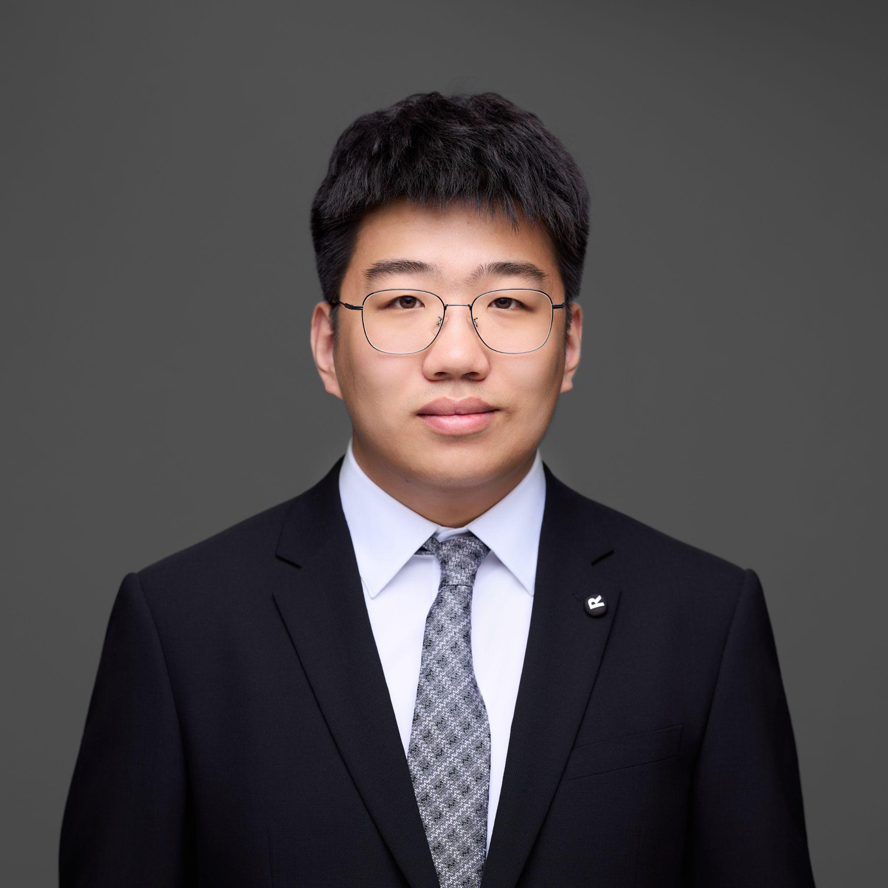
Meet A4ever
Tanvi Dhingra
Di Ma
Linlan Ma
Mike Mai
Alexander Tang
Louise Wang
Henry Yao
Notes:
:20 s

Slide 3

Business Need Overview
💬
Information Overload: Hard to recall names, roles, and personal details after events
❌
Missed Follow-Ups: Connections go cold without timely outreach
📝
Fragmented Notes: Details scattered across LinkedIn, notes, emails, and spreadsheets
📩
Generic Messaging: Forgetting context leads to impersonal thank-yous and weak engagement
Addressing Pain Points
⏰
Time Pressure: Busy schedules leave little room for organized follow-ups
👥
Competitive Disadvantage: Students who follow up better stand out in recruiting
Notes:
1:00

Slide 4



User Persona + Data Insights
Alice | Student | 23 Years Old | Lives in Los Angeles
Key Behaviors
Attends several networking events and finds multiple new connections per month
Struggles with organizing all her new connections
Currently pursuing an internship/full-time job
Client Survey Data
60% attended 8+ events and made 10+ connections in the past month
75%
?
?
?
?
?
?
?
?
?
0%
100%
30% made 30+ connections in the past month
75% forget conversation details after events
90% say a solution would add significant value
Notes:
:30
Our target user group is USC Marshall MSBA students.
Based on data we collected, we created a persona called Alice who attends many social events and connects with many people but struggles managing it which leads to her missing out on valuable opportunities.
However, Alice is not alone.75% admit they forget details just days after an event. Fortunately, we plan to create a product that 90% of our clients believe that it would bring significant value.

Slide 5

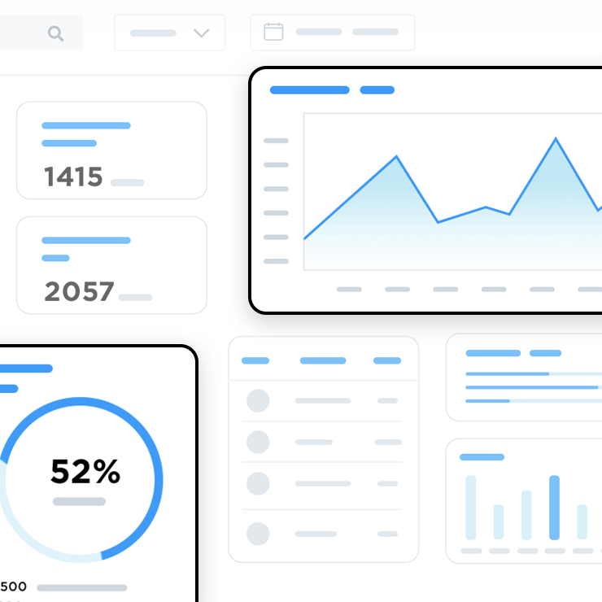


Unique Positioning
From Handshake to Hire: Owning the Relationship Gap
First Hand Shake
Nurture Relationship
Referral or Offer
Primary Tool
Our App’s Core Value
Strategic Advantage
State:
Scattered Data
Transformation: Organized Summary
Result: Data-Driven Actions
The Market Gap
Notes:
:50
Strategic advantage: giving a user a unique, sustained edge over other job seekers in the competitive networking process. It's not just about being more organized; it's about being more effective in a way that is difficult for others to replicate
We own the critical gap between the first handshake and the final offer. Our vision is to empower your first handshake to your first offer.
Our mission? To be your professional Notion for LinkedIn—turning chaotic conversations into a clear career playbook."
The journey starts with the 'First Hand Shake.' Your tool is LinkedIn, but the result is scattered data: messy notes and vague memories. This is where opportunities are lost."
Our app fills this gap by helping you nurture the relationship. We transform that chaos into an organized summary.
This gives our users a strategic advantage leading to the final phase: the 'Referral or Offer.' Instead of relying on luck, you can use data-driven actions—knowing exactly who to talk to and when. We help you build the relationships that ultimately land you the offer."

Slide 6
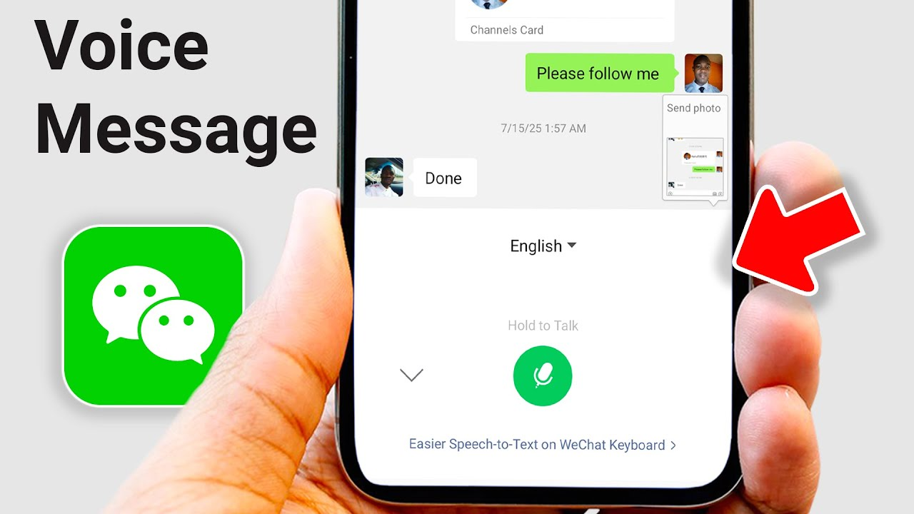
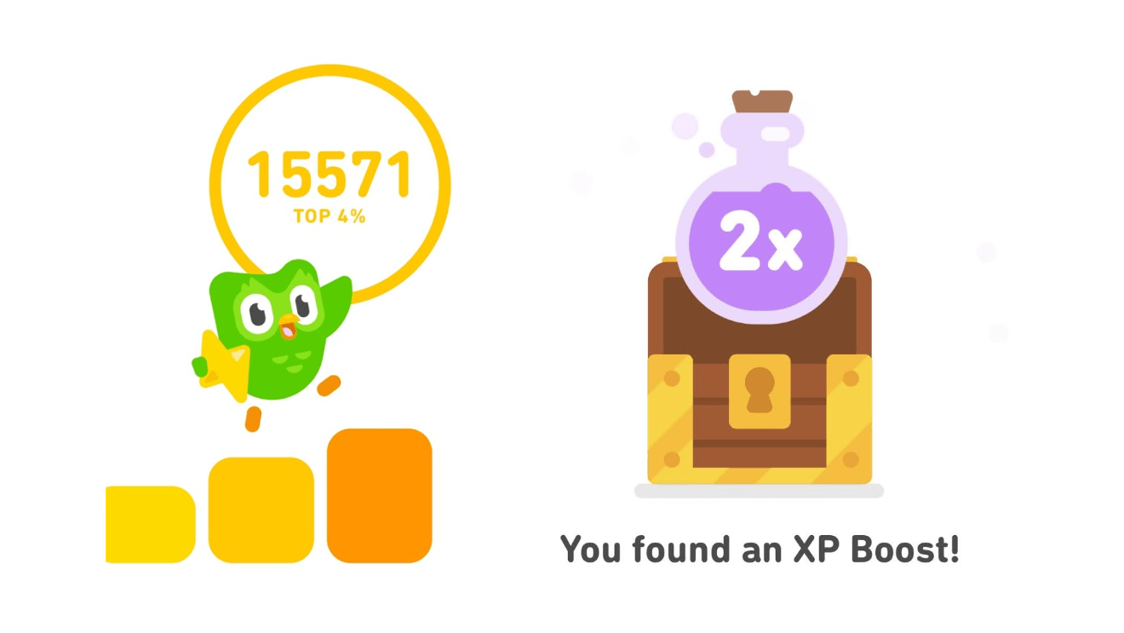
Key Features + Functionality
Smart Capture & Auto-sort
Data Input via Voice, Text, or Scan
AI Information Extraction & Auto-categorization
NLP Summarization
3-4 Key Highlights → Personalized Guidance
Reminder & Task Management
Remind to follow-up
A dashboard to track follow-up pipeline
AI Follow-up Draft
Generate follow-up emails and warm messages that feel personal - not robotic
Gamification/Streaks
Award Badges and Streaks for Consistent Follow-ups
Leveling Up & Unlock Levels
Notes:
1:20

Slide 7
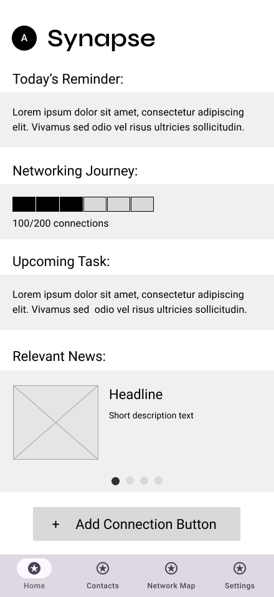
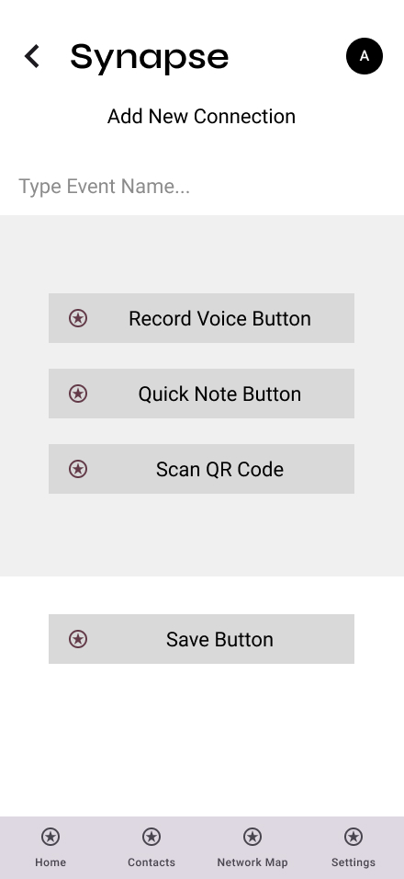
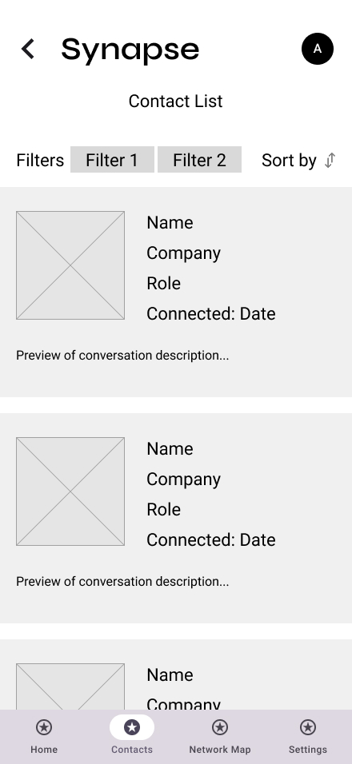
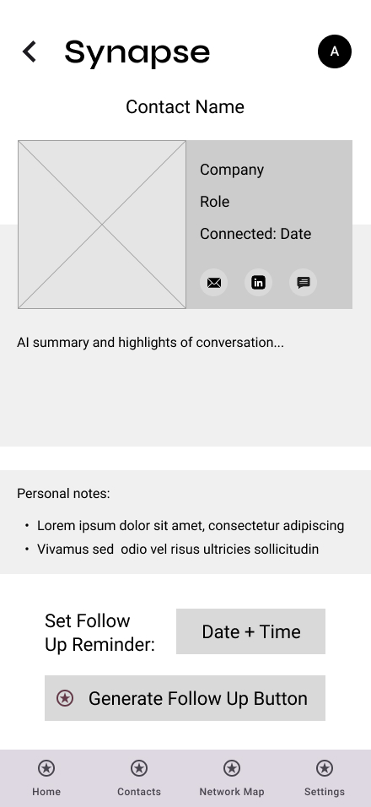
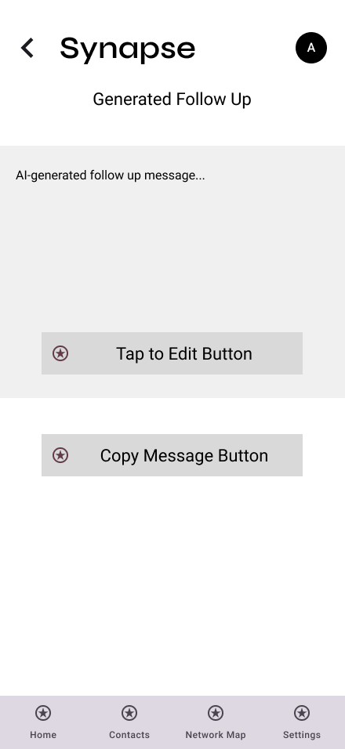
User Journey and Experience
Notes:
:45

Slide 8
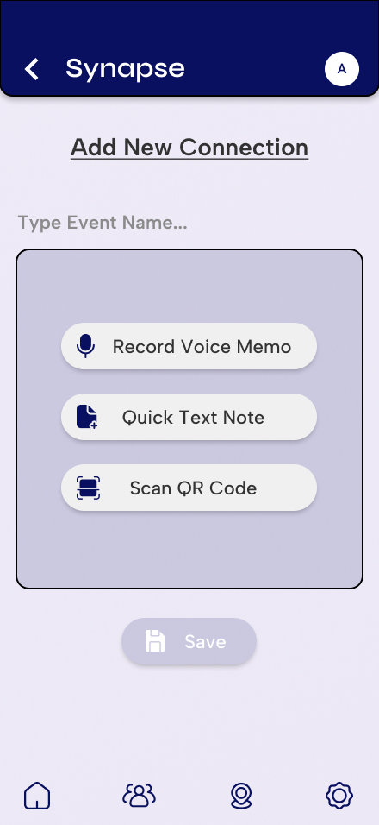
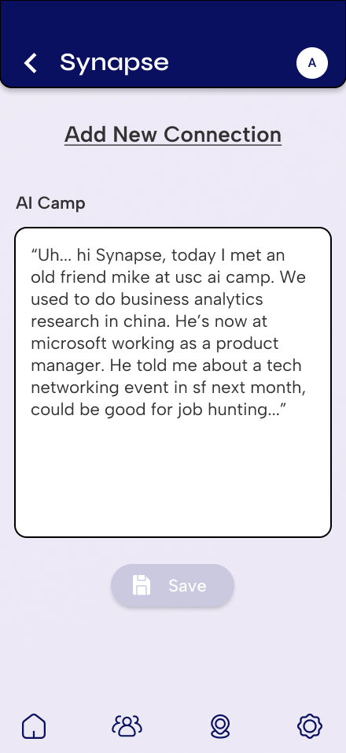
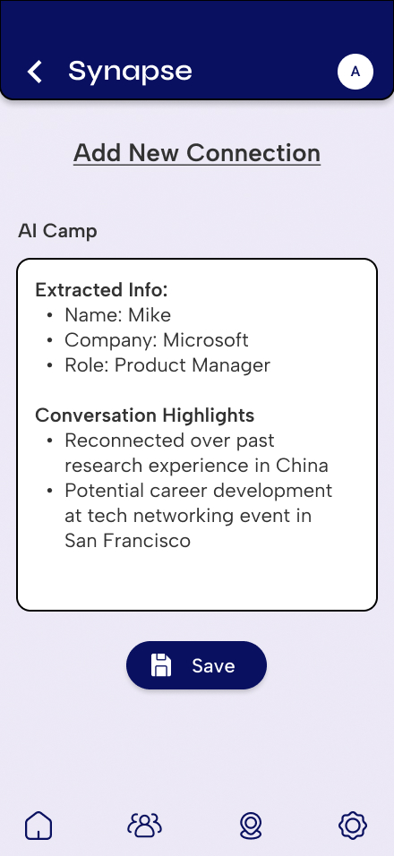
AI’s Role in User Experience
NLP Summarization
Notes:
:45

Slide 9
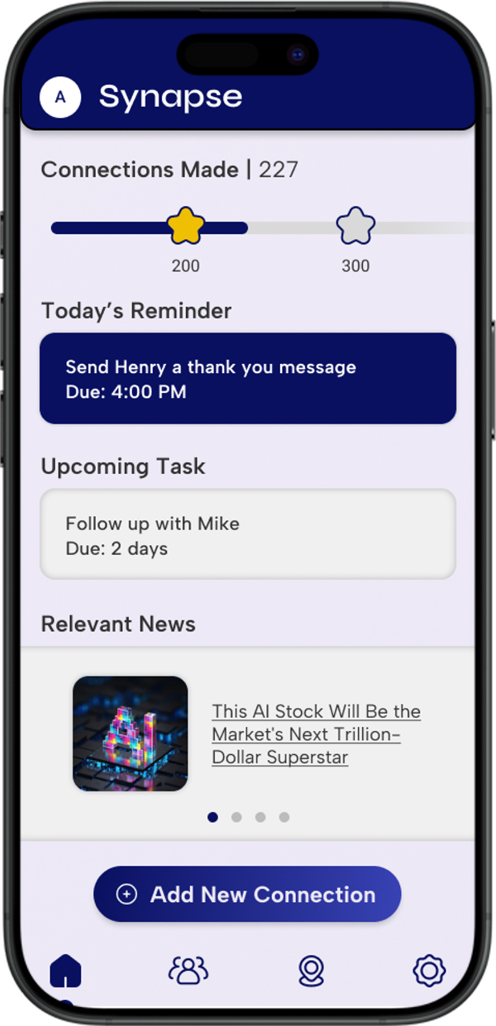
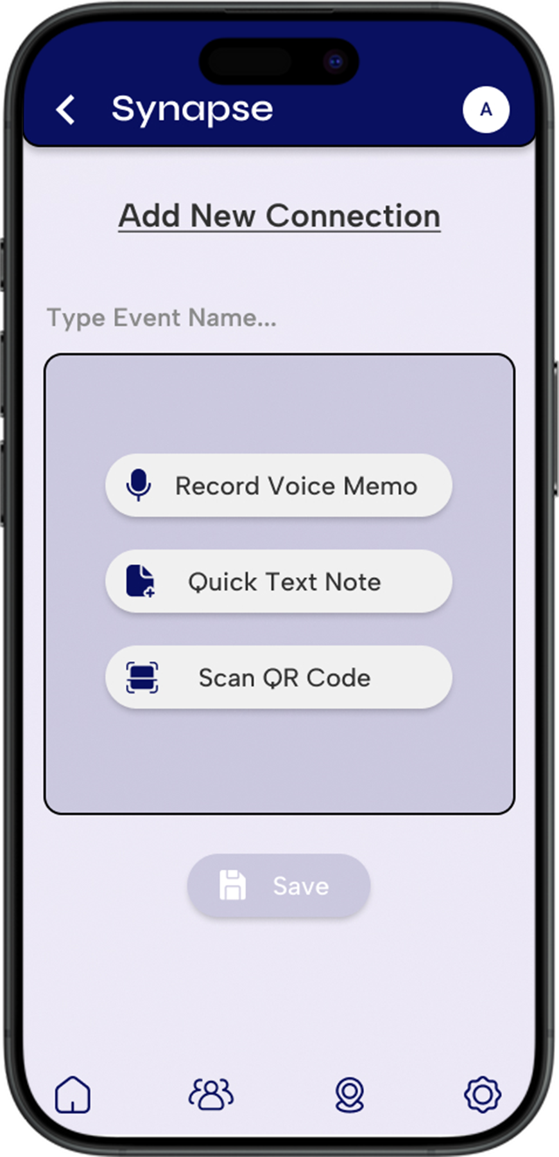
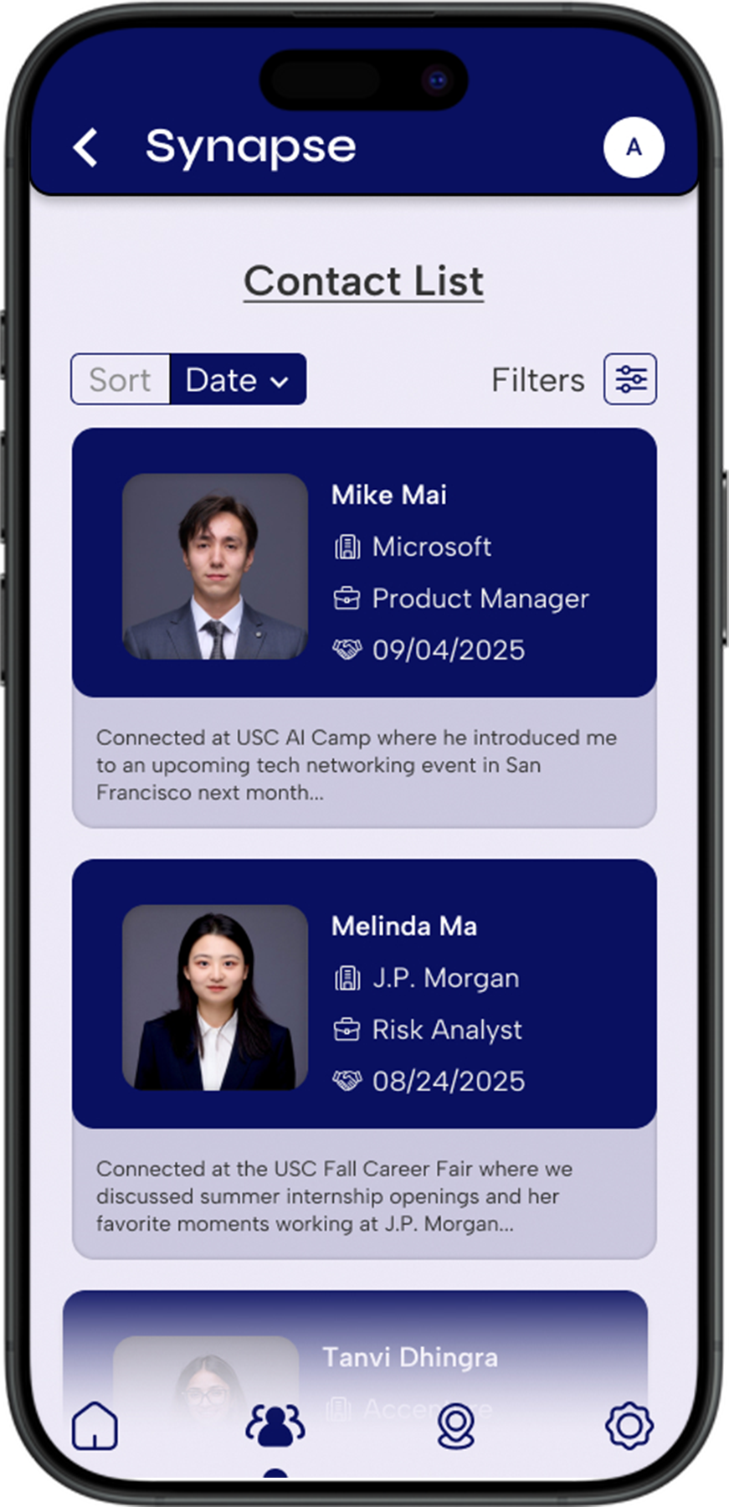
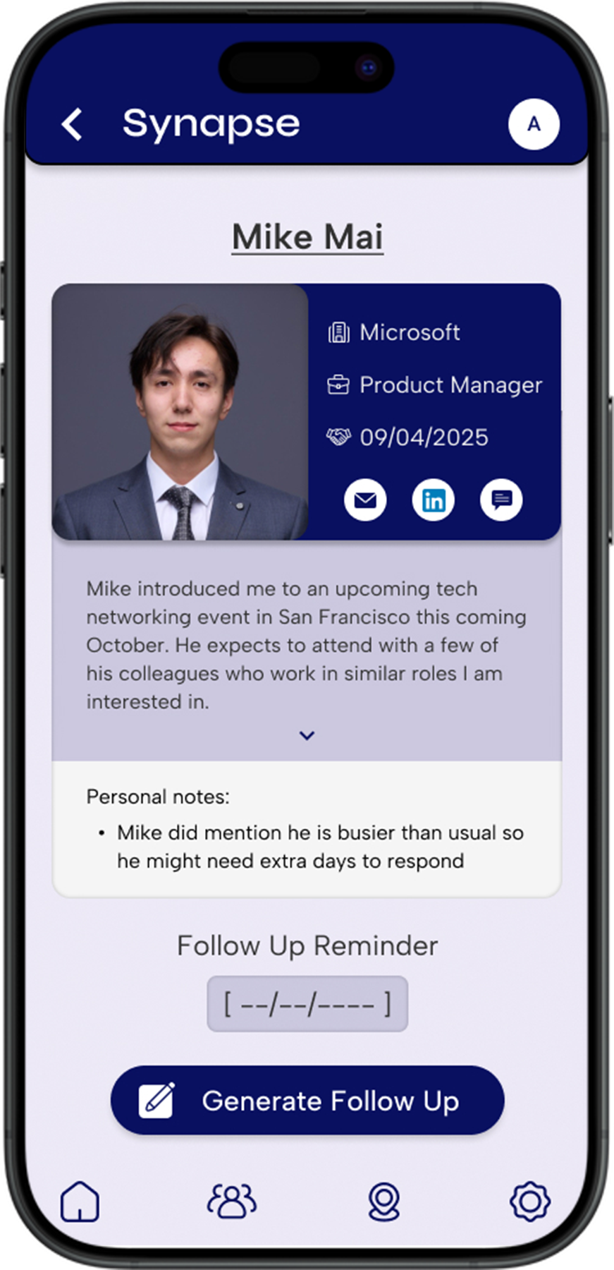
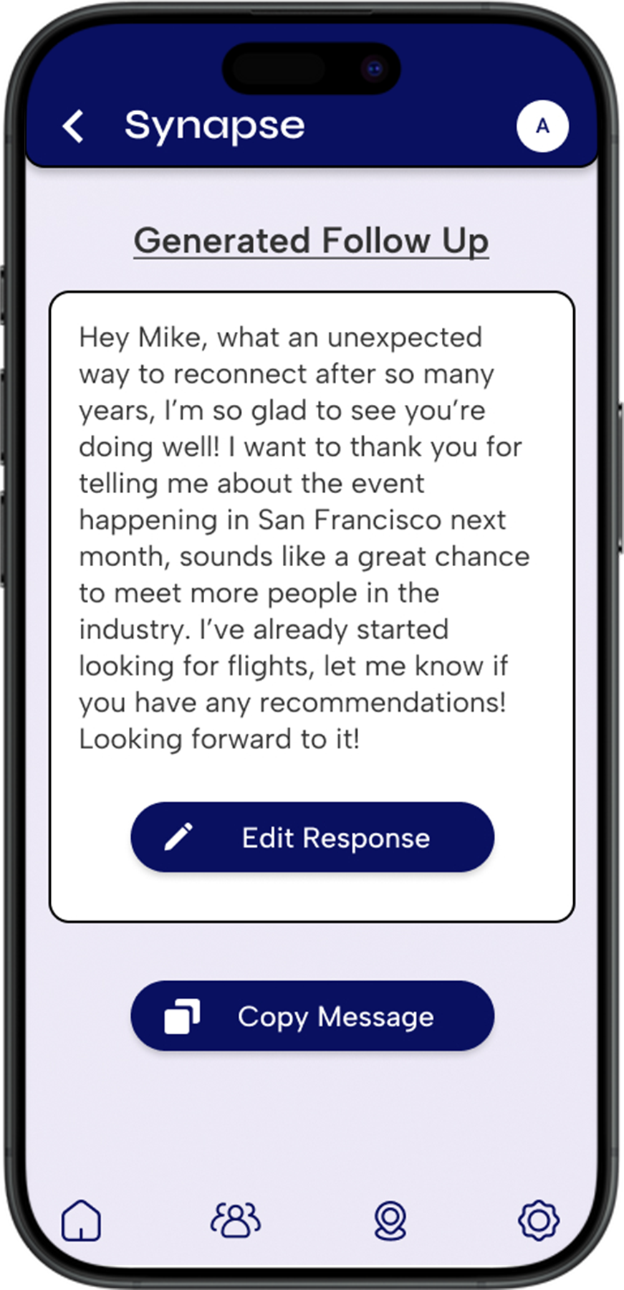
Notes:
:30

Slide 10
Privacy & Trust by Design
🔒 Privacy Concerns
📌 Solutions
Sensitive conversation notes may leak
Guests may feel uncomfortable being “recorded”
Uncertainty about where data is stored and who controls it
Opt-in only + encrypted local-first storage
No background recording, clear “visible only to you” message
User full control + Career Center endorsement for trust
Notes:
:20

Slide 11
Implementation Roadmap
Phase 1: Pilot (0–3 months)
Small pilot with 10–20 MSBA students
Test core workflow w/ low-fidelity prototype
Goal: Validate needs & collect feedback
Phase 2: MVP Rollout (3–6 months)
Release MVP with core features
Onboard more MSBA students with training & calendar integration
Goal: Build stable user base & early habits
Phase 3: Community (6–12 months)
Expand to whole MSBA community
Career Center endorsement + gamification
Goal: Make follow-up a community norm
Phase 4: Expansion (12+ months)
Extend to Marshall programs beyond MSBA
Add advanced features
Goal: Position it as Marshall’s standard networking journal
Notes:
:30

Slide 12
Successful Implementation
Behavior Change Mechanism | Successful Implementation Outcome
⏱ Calendar triggers | ≥80% follow-ups in 48h
⚡ Low-friction capture | Draft time ≤3min
🤖 AI follow-ups | Higher quality & confidence
🏆 Gamification | ≥80% weekly active usage
Notes:
:30

Slide 13
Thank You!
Now Open for Q&A

